Slide 1
PROJECT PRESENTATION ON MEGA APP (Food Ordering App)
PROJECT GUIDE PROJECT INCHARGE
MD. SHADAB HUSSAIN Mr. ASHISH AGARWAL
PROJECT MEMBERS
NAMAN MADIRATTA(1701410065)
TUSHAR SINGH(1701410107)
SUGAM RAIZADA(1701410102)
GROUP NO. 8

Slide 2
CONTENTS
Introduction
Objective
Requirement Specification
Methodology
List of Modules
Applications
Advantages
Limitations
Block Diagram
Activity Diagram
Screenshots
Future Scope
References

Slide 3
INTRODUCTION
With the increasing popularity of food delivery in daily life , the traditional telephone order food has inconvenience to the customers and the food delivery store. Until very recently, all of these delivery orders were placed over the phone, but there are many disadvantages to this system, including the inconvenience of the customer needing to have a physical copy of the menu, lack of a visual confirmation that the order was placed correctly, and the necessity for the restaurant to have an employee answering the phone and taking orders.
The online food ordering system provides convenience for the customers. It overcomes the disadvantages of the traditional queuing system.

Slide 4
OBJECTIVE
A food delivery app focuses on making the process of food ordering easy and convenient for the customers. The main aim of food ordering app is to develop food ordering system using mobile application which will help customers to manage their food ordering. The System is User Friendly so that any person using it will not face any difficulties in operating it.
The system has facilities that allow users to view menu card, select the items as required, add them to cart, view menu card, select the items as required, view special discounts on food items, select a food delivery, rate the items and services provided.
Less time consuming hence increases the efficiency of the system.

Slide 5
REQUIREMENT SPECIFICATION
REQUIRED HARDWARE
Laptop or PC
i3 Processor Based Computer or higher
2GB RAM
5 GB Hard Disk
Android Phone or Tablet
1.2 Quad core Processor or higher
2 GB RAM
REQUIRED SOFTWARE
Tools Used
Android Studio
Android SDK
Technologies Used
Android
Java/Kotlin

Slide 6
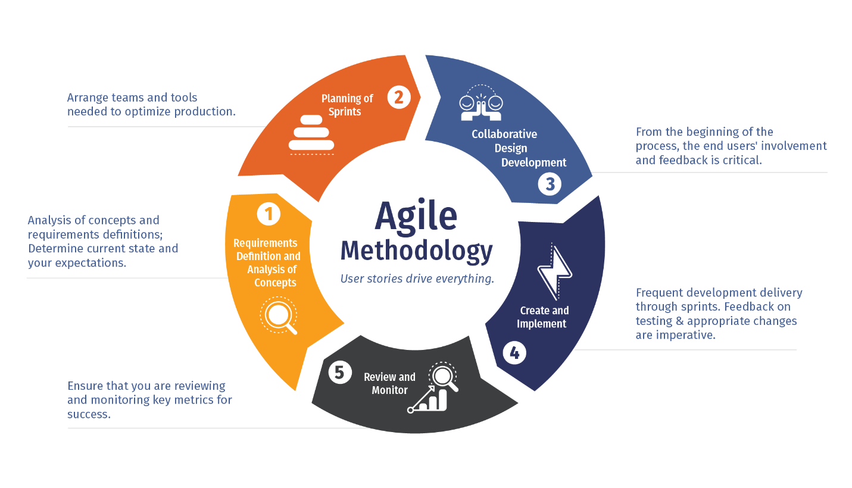
METHODOLOGY
As mentioned before one goal of this project is to provide hustle free environment for customers for online food ordering by viewing list of restaurants , their menus and order food online. These conditions are bound to many variables, and the method used here in this project is the Agile methodology. Agile software development describes an approach to software development under which requirements and solutions evolve through the collaborative effort of self-organizing and cross-functional teams and their customer(s)/end user(s). It advocates adaptive planning, evolutionary development, early delivery, and continual improvement, and it encourages rapid and flexible response to change.

Slide 7
LIST OF MODULES
User Module : User have option to choose the cuisine, hotels of nearby. User will get details of restaurant like name, location and reviews. User will can select the food from the menu list, can add to favorites and can processed further. User can view the history of their orders and the current orders status.
Register: User can register and get login
Login: User can login using credentials.
Profile: User can set their profile.
Change Password: User can change their password.
Cuisine: User can select list of cuisines. Can also list hotels and search for the desire restaurant.
Restaurant: Restaurant Details been shown like address, location, reviews and ratings.
Menu: list of Menu with price, details and photos. Filter menu by Kind of Food e.g.: Appetizers, Main course, Sides etc. Proceed to Order, Cart Page - Modify deleted items, Order Confirmation/Payment/COD etc.
Orders: Users can view the pervious and current order history and also can track the order.
Favorites : Favorites Food/remove from Favorites.

Slide 8
APPLICATIONS
Overcomes the disadvantage of the traditional queuing system.
Enhances speed of ordering foods.
Takeaway of foods.
Free delivery.
Advanced sorting functions.

Slide 9
ADVANTAGES
More convenient and easy to use.
No need to waste time standing in long queues.
More options to choose from.
24X7 availability.
Lower prices with better discounts.

Slide 10
LIMITATIONS
The application requires active internet connection.
Lack of internet knowledge to customers.
Sometimes delivery process may take time.
Limited number of menu choices.
No bargaining.

Slide 11
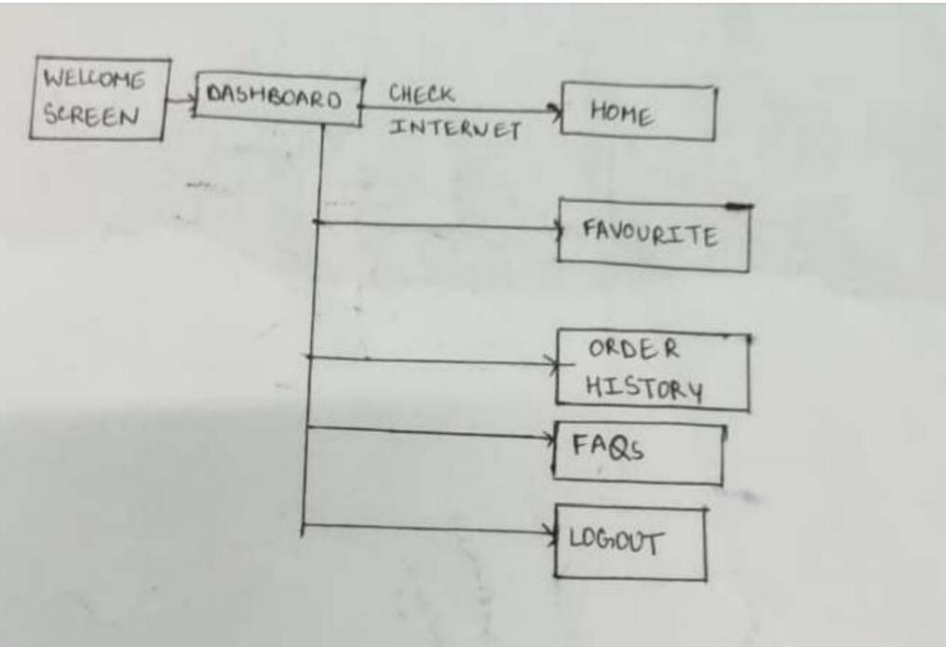
BLOCK DIAGRAM

Slide 12
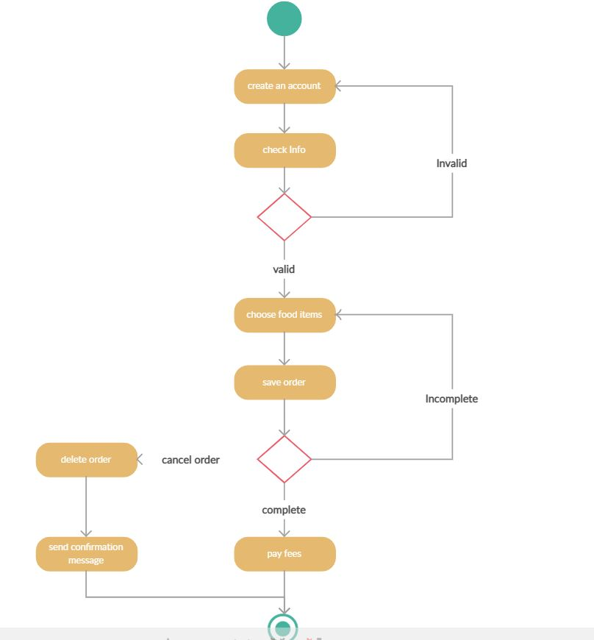
ACTIVITY DIAGRAM

Slide 13
SCREENSHOTS

Slide 14
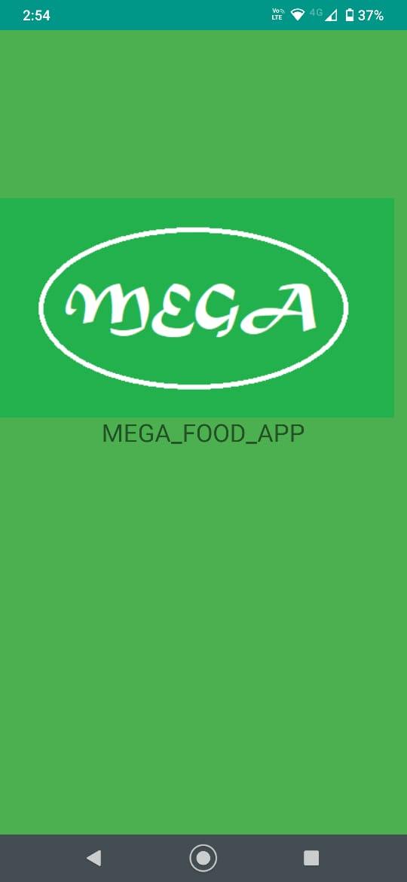
Opening of the App with a Splash Screen for 1.5sec, presenting the App Logo and App Name.
Login by entering suitable details.
If already Logged-in, Home Page is opened directly!
Option to register or change password are present on page.
Splash and Login Page

Slide 15
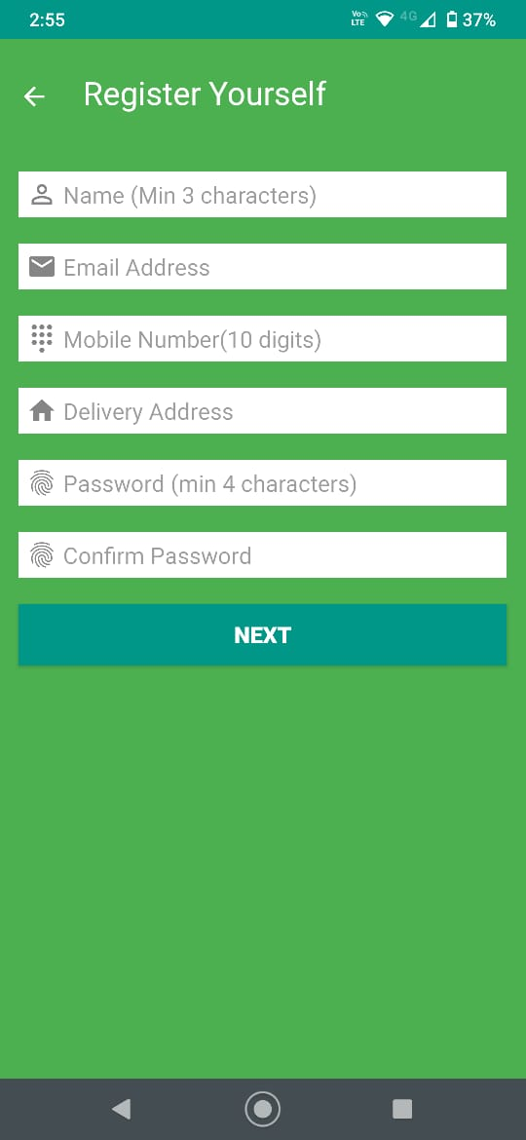
Register onto the Database by providing your details.
If successfully registered, you're forwarded to Home Page.
Registration Page

Slide 16
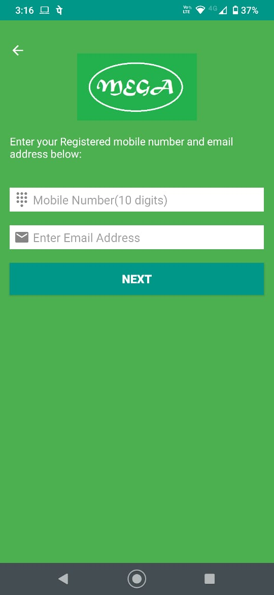
An OTP(valid for 24 hours) is sent to registered Email address by providing Email and Phone Details.
If successful, you're directed to Change Password Page. Change your password by providing new password along with the sent OTP within 24hrs.
If successful, you're directed to Login Page.
Forgot Password Page

Slide 17
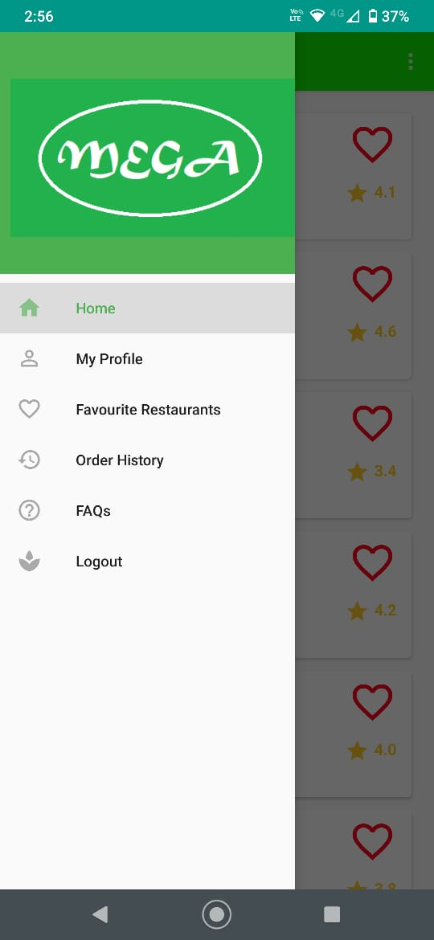
Home Screen consists of a Drawer Menu, displaying App Name with menu item.
Clicking on Menu items will open corresponding fragment.
Navigation Drawer

Slide 18
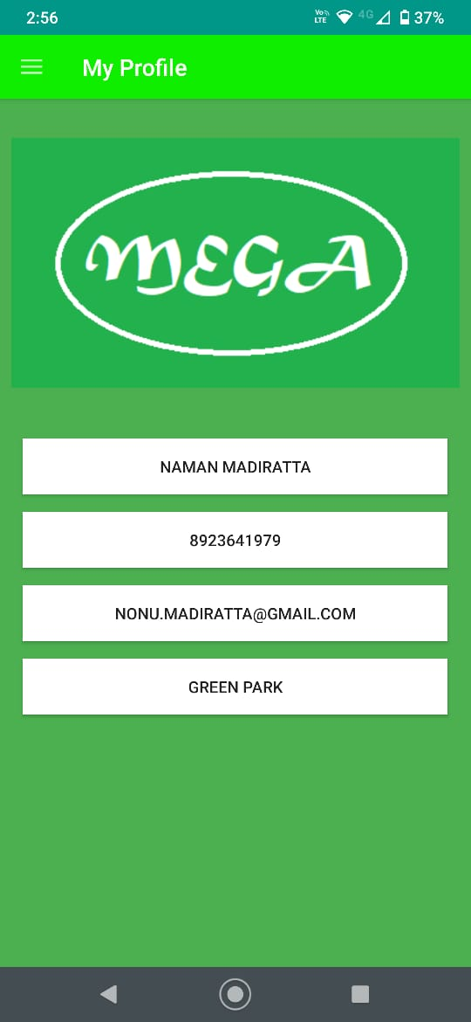
Profile fragment displaying User's Name, Number, registered email address and delivery address.
Profile

Slide 19
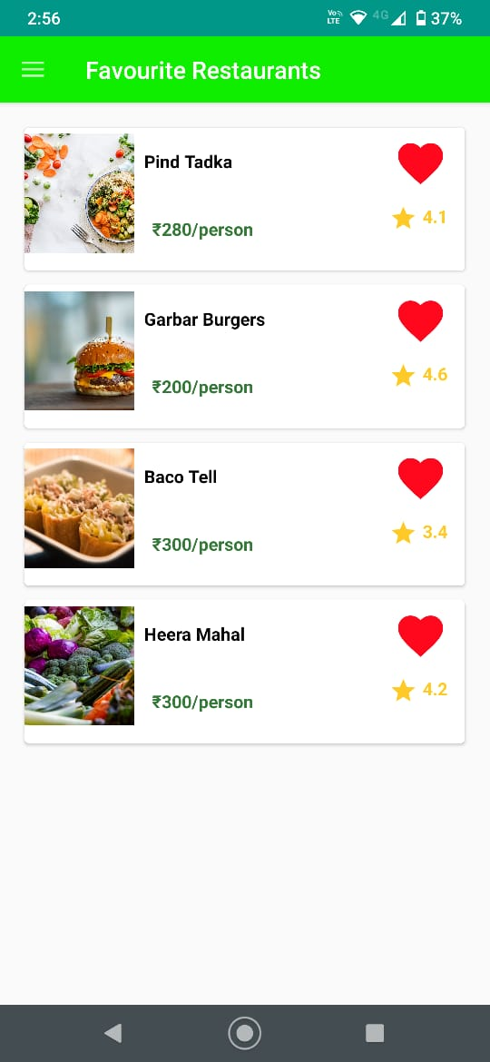
Favourites fragment displays all your favourite restaurants in a list format.
Restaurants when clicked, displays its information on Description Page.
Option to remove a restaurant from favourites is also present.
Favourites

Slide 20
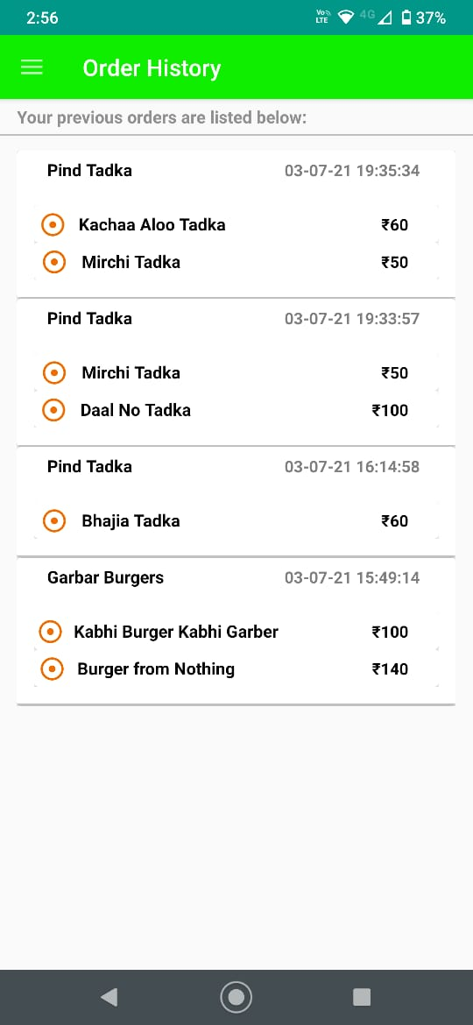
Displays a list of all the Previous orders, along with Restaurant Name and order time, with price of each ordered item.
Order History

Slide 21
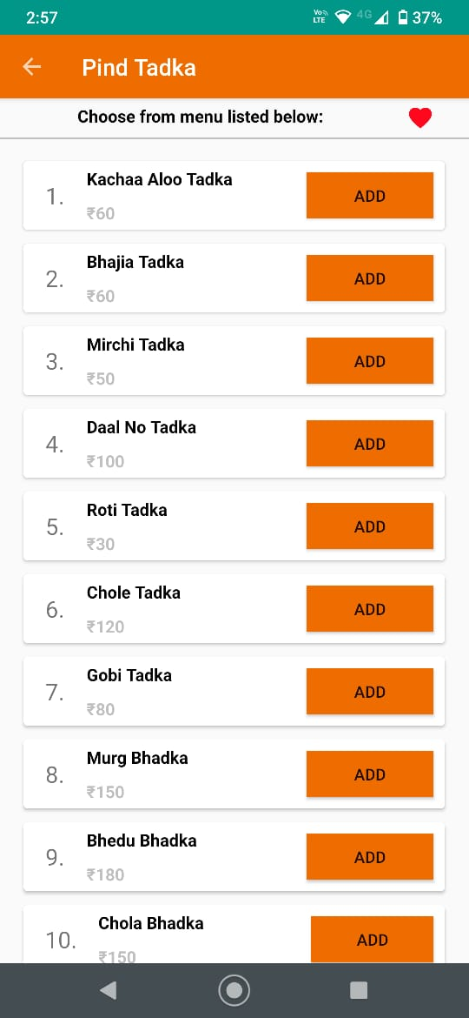
Displays the restaurant's menu with the Dish's name and price.
Option to add dish on cart and proceed to order is present along with to add restaurant in Favourites.
Restaurant Description

Slide 22
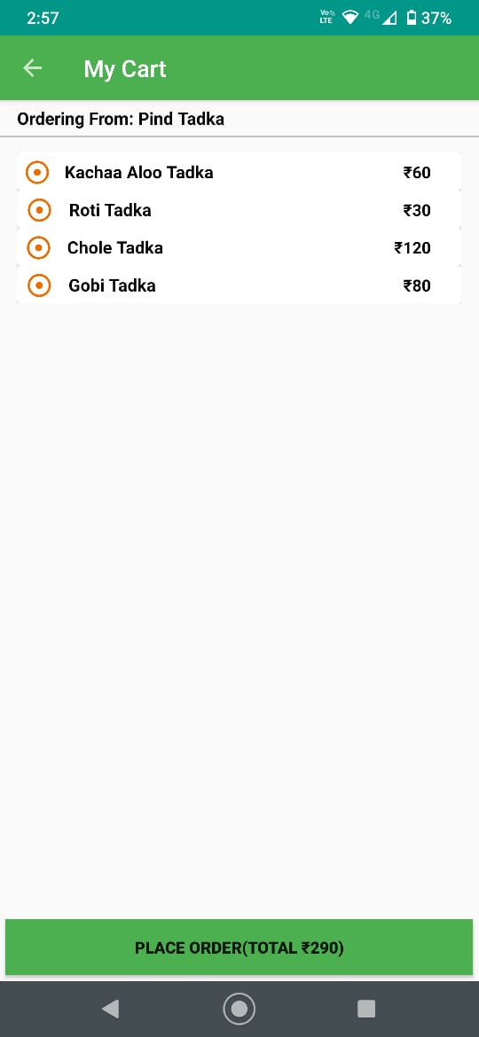
Displays the current order with its details and when ordered displays order confirmation page.
Cart and Confirmation

Slide 23
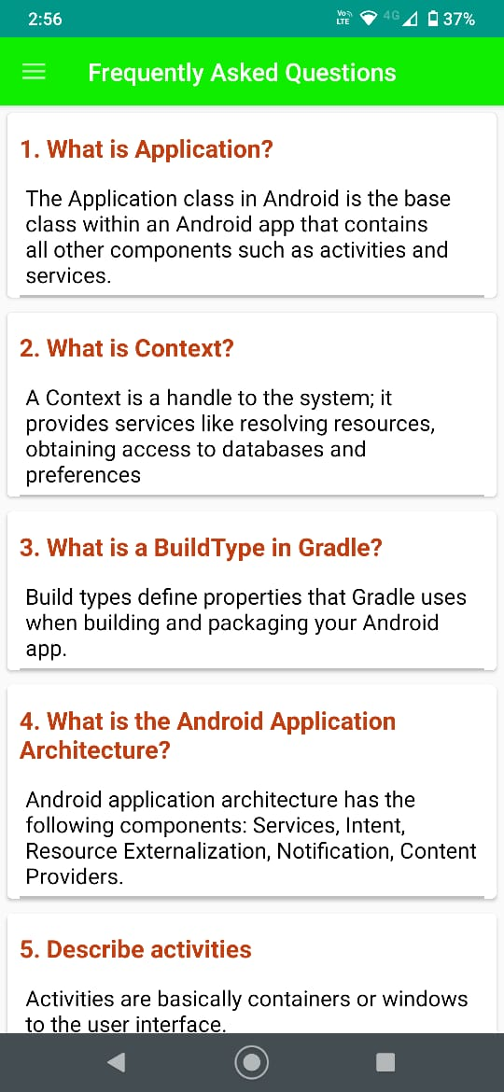
Displays Frequently Asked Questions in a list manner.
FAQ’s

Slide 24
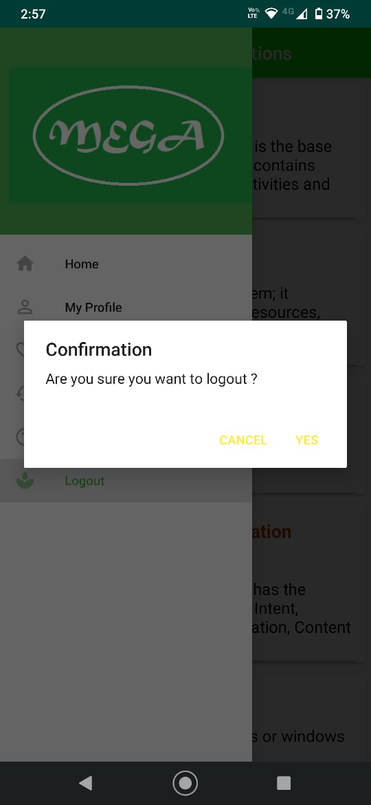
Displays an Alert Dialog for confirmation to logout from the App
Logout Confirmation

Slide 25
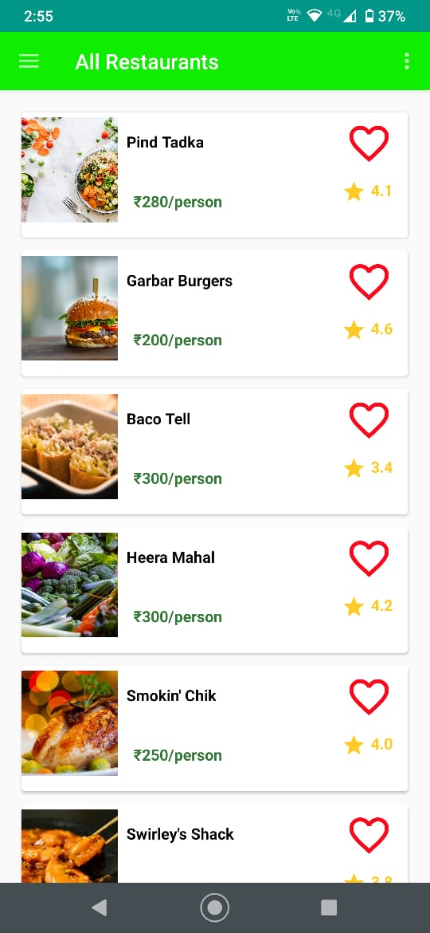
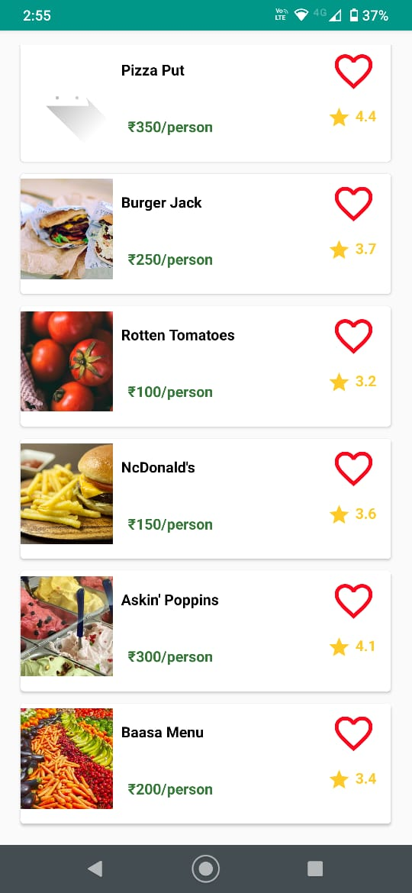
Restaurants Names

Slide 26
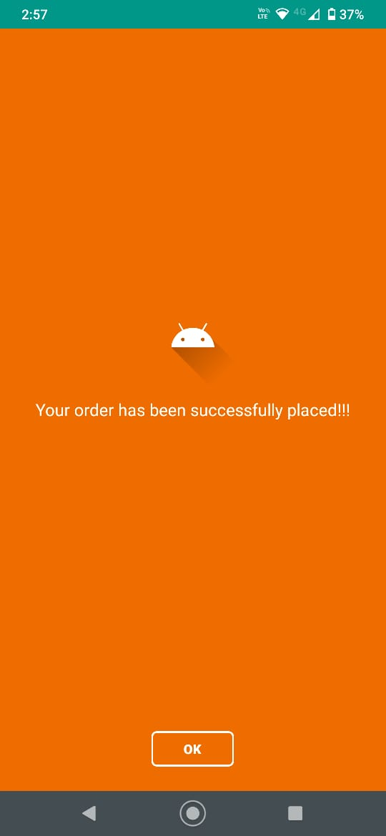
Order History

Slide 27
Future Scope
Payment gateway.
Chat box.
Tracking order.
Food Pre-Ordering
Push Notifications
Admin module

Slide 28
REFERENCES
https://nevonprojects.com/android-food-order-and-delivery-app/
https://developer.android.com/
https://www.tutorialspoint.com/android/index.htm
https://www.geeksforgeeks.org/android-tutorial/
https://www.javatpoint.com/android-tutorial

Slide 29


